Slide 1
T
Trishna 3D
SYSTEM SPECIFICATIONS
Architectural Intelligence
Next-Generation 2D Floor Plan → Intelligent 3D Multi-Storey Reconstruction
Supported Inputs
PDF (Vector/Raster), PNG, JPG, CAD Sheets
Map Fidelity
Instantly reconstructs real-scale 3D residential environments from standard 2D blueprints, raster plans, and CAD sheets. Features multi-storey continuous staircases, auto-detecting inward-facing doors, and progressive bottom-to-top construction transitions.
100% boundary matching (10m × 14m specs)
Core Engine
Three.js WebGL + Google Gemini Vision
Navigation
Free First-Person + Orbit / Drone Mode
✦ 100% Client-Side WebGL 2.0 (Zero Server Latency)
Door Physics
Auto-swing inward doors (secure perimeter)
✦ Continuous Multi-Storey Stair Kinematics
Build Animation
Timed bottom-to-top progressive assembly
✦ Cinematic Bottom-to-Top Progressive Construction
Trishna 3D Studio · 2026

Slide 2
01 / PROBLEM STATEMENT
Existing Technologies & Current Market Limitations
DESKTOP CAD
2D VIEWERS
CLOUD RENDERERS
Legacy CAD & BIM Tools
(AutoCAD / Revit / SketchUp)
Traditional Web 2D
Plan Viewers
Generic Cloud 3D
Rendering Services
High licensing costs and steep learning curves for clients and property buyers.
Requires heavy dedicated GPU workstation hardware; impossible to share instantly on client browsers.
Manual 3D modeling and texturing takes hours or days for multi-storey residential blueprints.
Static PDF or flat image displays with zero spatial depth, scale comprehension, or physics.
Difficult for homeowners and non-architects to visualize room heights and circulation flow.
Zero first-person walking walkthrough or multi-floor vertical staircase exploration.
Require slow server-side asset baking with multi-minute remote queue wait times.
Sensitive architectural documents and blueprints sent and stored on third-party servers.
Lack intelligent automated room boundary recognition and multi-floor vertical stair core alignment.
Trishna 3D — Intelligent Architectural Reconstruction

Slide 3
02 / OUR INNOVATION
Our Technology: Automated Spatial Intelligence & Rebuild Engine
01
Instant 2D Plan Recognition
02
Mathematical 3D Assembly
Processes both scanned raster PDFs/PNGs via Google Gemini Multimodal Vision AI and native vector CAD drawings with sub-second parsing and intelligent room label classification.
Procedurally computes exact wall coordinates, thickness, door frames, windows, continuous floor slabs, and cantilevered balconies with 100% scale fidelity to the input plan.
03
Bottom-to-Top Construction Transition
04
Seamless First-Person Walkthrough
Realistic timed architectural build-up animation showing ground foundation, upper villas, partition walls, and roof terrace rising progressively with live HUD progress indicators.
Free multi-floor navigation through stair portals, inward-facing auto-opening doors, collision-free trees, and outdoor plinth grounds with smooth camera ergonomics.
Trishna 3D — Intelligent Architectural Reconstruction

Slide 4
03 / ARCHITECTURE & STACK
Complete Technology Stack & Roles in Trishna 3D
Three.js (WebGL 2.0)
Renders 60 FPS diorama, soft shadow mapping (PCFSoftShadowMap), filmic tone mapping, raycasting door interaction, and first-person camera walkthrough kinematics.
3D Real-Time Graphics Engine
Google Gemini Vision AI
Extracts rooms, spatial dimensions, floor levels, stair cores, and functional types directly from complex raster drawing sheets & blueprint scans.
Multimodal Spatial Recognition
React 18 & TypeScript
Strict type safety for architectural schedules, procedural coordinate calculations, HUD timeline management, and responsive reactive rendering.
Component State & Architectural Schema
PDF.js (Mozilla)
High-resolution viewport rasterization and vector text-operator clustering directly inside client browser memory with zero server uploads.
In-Browser Vector & Raster Parsing
Vite 5 & Modern CSS3
Sub-second Hot Module Replacement, zero backend latency, and responsive glassmorphic interfaces themed in calming pastel greens.
Build Pipeline & Pastel Green Aesthetic
Trishna 3D — Intelligent Architectural Reconstruction

Slide 5
04 / CORE TECHNOLOGY DEFINITIONS
Deep Dive Technical Definitions: How Each Module Operates
GEOMETRY ENGINE
KINEMATICS SYSTEM
TIMELINE ANIMATION
Procedural Wall & Door Engine
Collision & Stair Travel System
Progressive Stage Interpolation
Mathematical boundary parsing & inward-facing door automation
Kinematic capsule navigation across multi-storey landings
Bottom-to-top progressive construction animation
Automated boundary edge-matching algorithm with 0.9ft tolerance that detects adjacent rooms, generates shared partition walls, and places inward-facing doors while enforcing solid garden exterior walls. Guarantees 100% perimeter security with zero unintended exterior entrances.
Custom kinematic collision controller providing free stair traversal, height interpolation across multi-storey landings, auto-swinging door triggers, and 100% collision-free garden tree perimeters. Allows the user to seamlessly climb from ground level to upper storeys and terrace without getting trapped.
Physics-inspired bottom-to-top growth timeline using cubic easing curves (easeInOutCubic) to scale floor roots, extrude structural slabs, and raise partition walls sequentially across ground, first, and terrace levels. Provides an engaging 7-second visual building experience before enabling free walking.
Trishna 3D — Intelligent Architectural Reconstruction

Slide 6
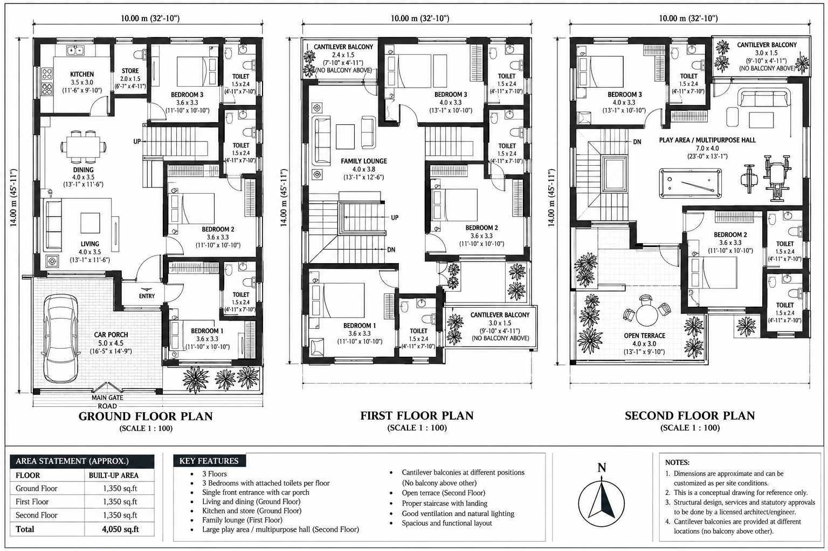
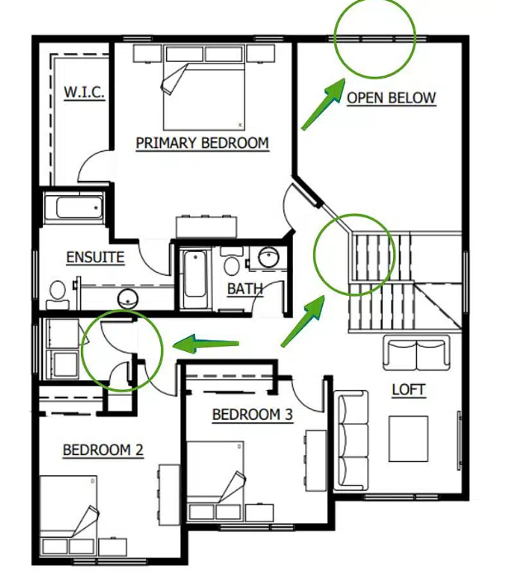
05 / SYSTEM SCREENSHOTS & COMPARISON
Visual Evidence: 2D Blueprint Input vs Real-Time 3D Output
INPUT
10.00m × 14.00m Multi-Floor Drawing Sheet
OUTPUT
Real-Time 3D Walkthrough Studio in Three.js
Multi-floor sheet (Ground, First, Second Floor) with room dimensions and continuous stair core.
Free walking mode with inward-facing doors, solid slabs, and bottom-to-top construction transition.
Trishna 3D — Intelligent Architectural Reconstruction

Slide 7
06 / CONCLUSION & SUMMARY
Project Milestones, Quantitative Impact & Future Roadmap
100%
7 sec
0 ms
3-Floor
Map Accuracy
Progressive Build
Server Latency
Multi-Storey
Exact reproduction of 10m × 14m drawings including attached baths, stairs & balconies.
Real-time stage-by-stage construction animation from ground to roof terrace.
Runs entirely in the user’s browser with zero cloud render wait queues.
Fully walkable continuous staircase connecting all residential levels freely.
FINAL VERDICT
Trishna 3D proves that modern browser technologies (Three.js WebGL) combined with multimodal vision AI can transform static 2D blueprints into walkable, photo-realistic, multi-storey architectural experiences with zero server wait times or workstation dependencies.
Future Scope: Automatic CAD DXF/IFC export, WebXR VR headset walkthroughs, and real-time collaborative multi-client spatial review.
Trishna 3D — Intelligent Architectural Reconstruction

